Slide 1
Super Luigi Brothers
Megan Adamik, April Yang, Matthew Rozinskas, Marianna Sanchez, Anthony Hernandez

Slide 2
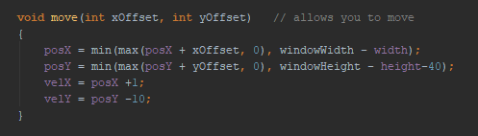
Player and Enemy Classes
The player and enemy classes were created with bounds on the height of the window but not on the width to enable traveling through the walls from one side to the other.

Slide 3
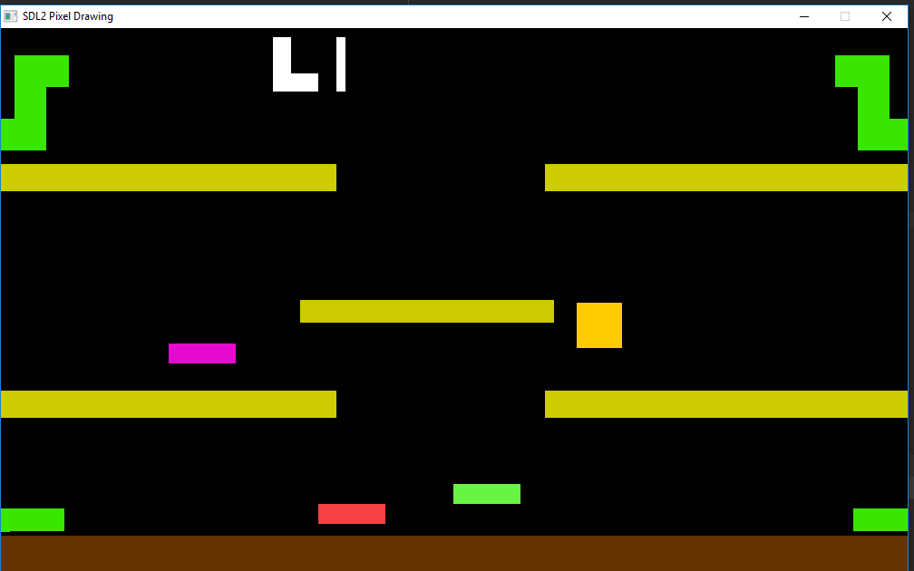
Platforms and Overall look of the game

Slide 4
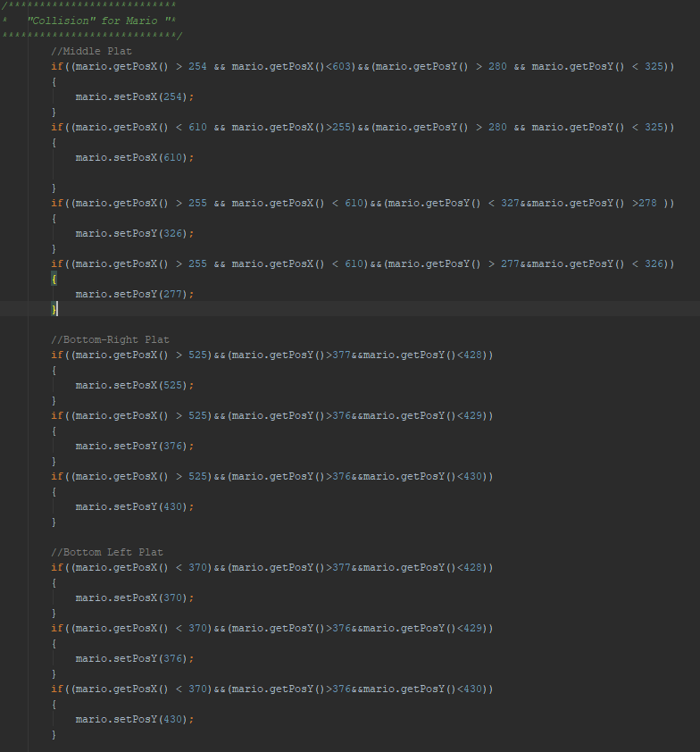
Collision
If collision is detected on a platform or the floor then the program does not allow the player to go through it.

Slide 5
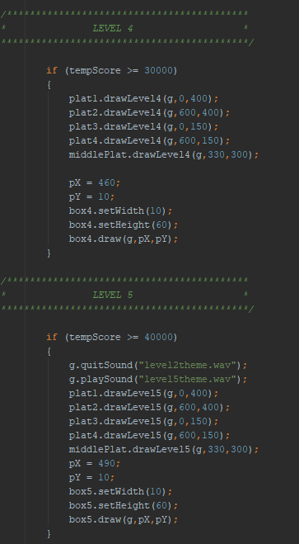
Levels and Score
The levels change depending on the score achieved by the player
Points are achieved by being alive
The token class was created with an automatic movement function and no bounds on the width of the screen to continuously travel.

Slide 6


Bonus
Playing the game with 2 players is available and it is a cooperative game
Theme music plays when the players begin to play and continues to play until the player loses all of their lives or they quit the game.
Press C to advance to the “secret” Christmas level for a surprise

Slide 7
Goals that were not achieved
Sprites and actual graphics
No point class, no implementation of graphics from files
No collision between the players and enemies and the tokens
Tokens and enemies do not disappear or collide with the two players nor can the two different players collide with one another.
Jumping parabolas
Collision works but gravity was never implemented

